Slide 1

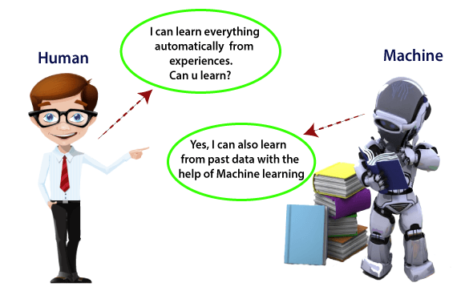
ASSIGNMENT –I DEEP LEARNING TEJAAL M ENG19CS0334 SEM V F section

Slide 2

DAYANANDA SAGAR UNIVERSITY
DEPARTMENT OF COMPUTER SCIENCE & ENGINEERING
SCHOOL OF ENGINEERING
Dayananda Sagar University
Kudlu Gate
Bangalore – 560068
REPORT
ON
“MACHINE LEARNING”
SUBMITTED TO THE 5TH SEMESTER DEEP LEARNING COURSE
BACHELOR OF TECHNOLOGY
IN
COMPUTER SCIENCE & ENGINEERING
SUBMITTED BY
TEJAAL M
ENG19CS0334
SEM V
F SECTION
UNDER THE SUPERVISION OF
MR. CVSN REDDY

Slide 3
CONTENTS
1 | INTRODUCTION TO MACHINE LEARNING
2 | SUPERVISED, UNSUPERVISED AND REINFORCEMENT LEARNING
3 | PROCESS OF DATA WAREHOUSE AND DATA MINING
4 | MACHINE LEARNING ALGORITHMS LINEAR REGRESSION LOGISTIC REGRESSION DECISION TREE RANDOM FOREST KNN SVM
5 | APPLICATION OF ML IN DIFFERENT DOMAINS-HEALTH CARE, TELECOM

Slide 4
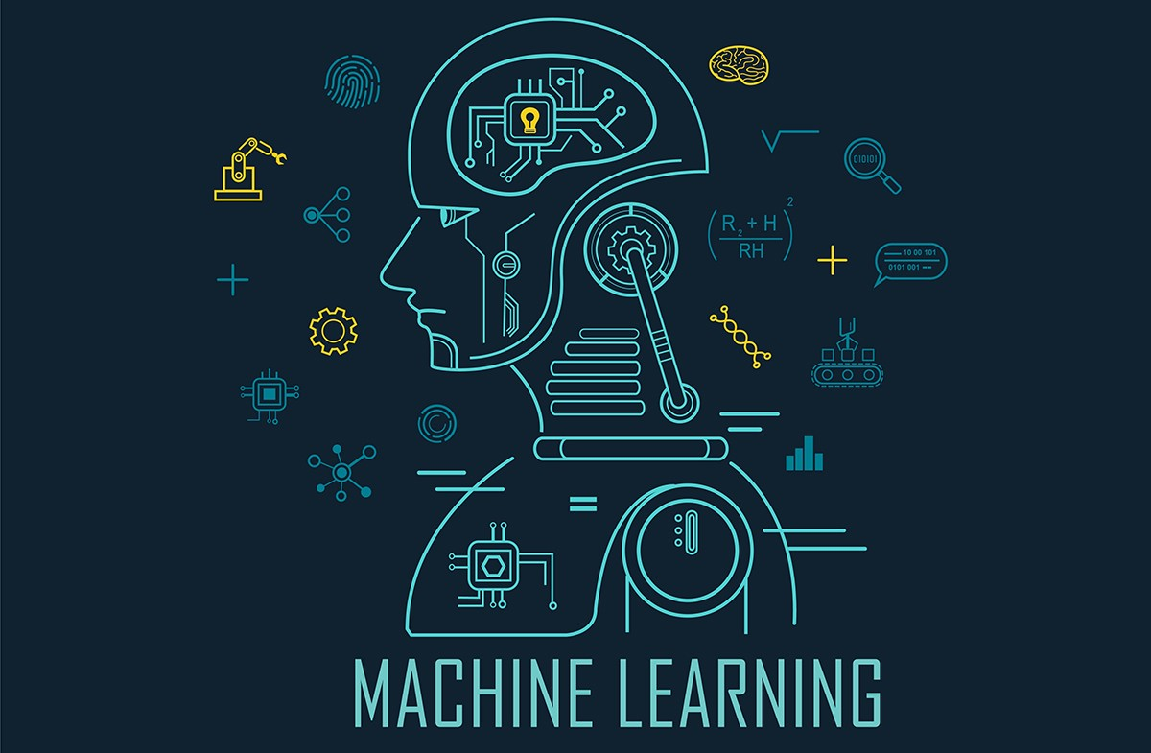
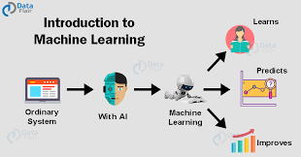
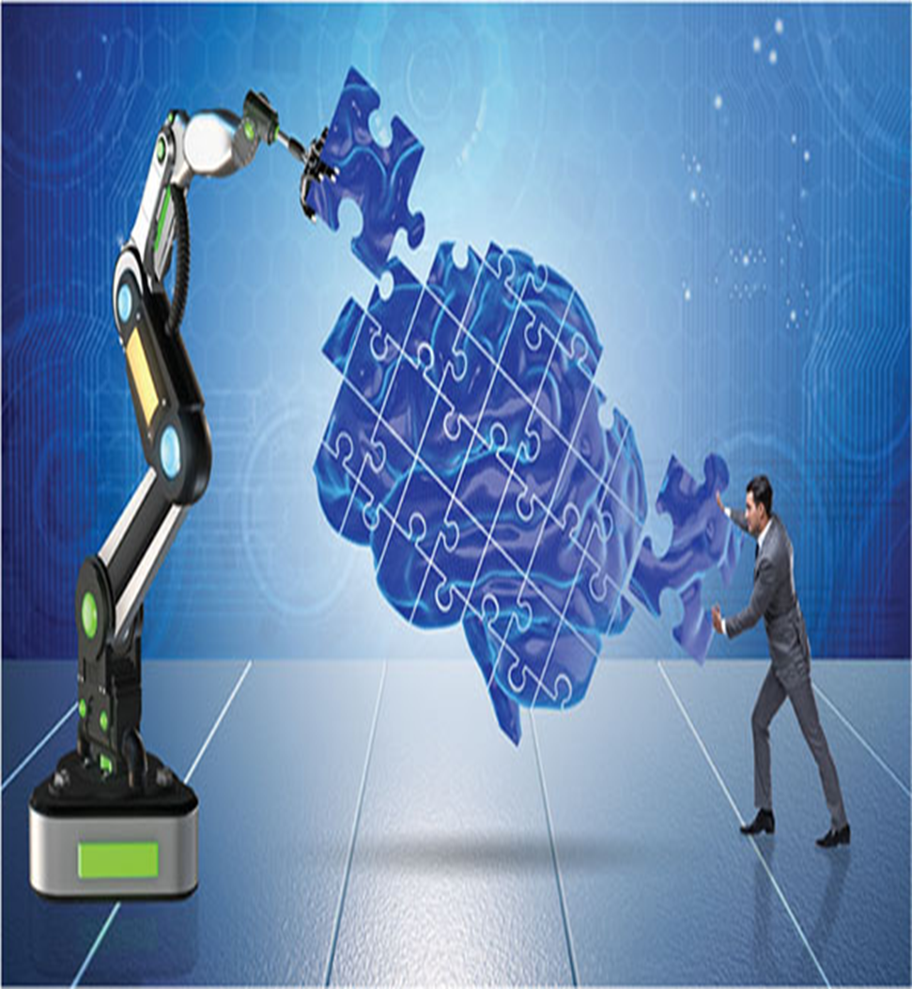

Slide 5
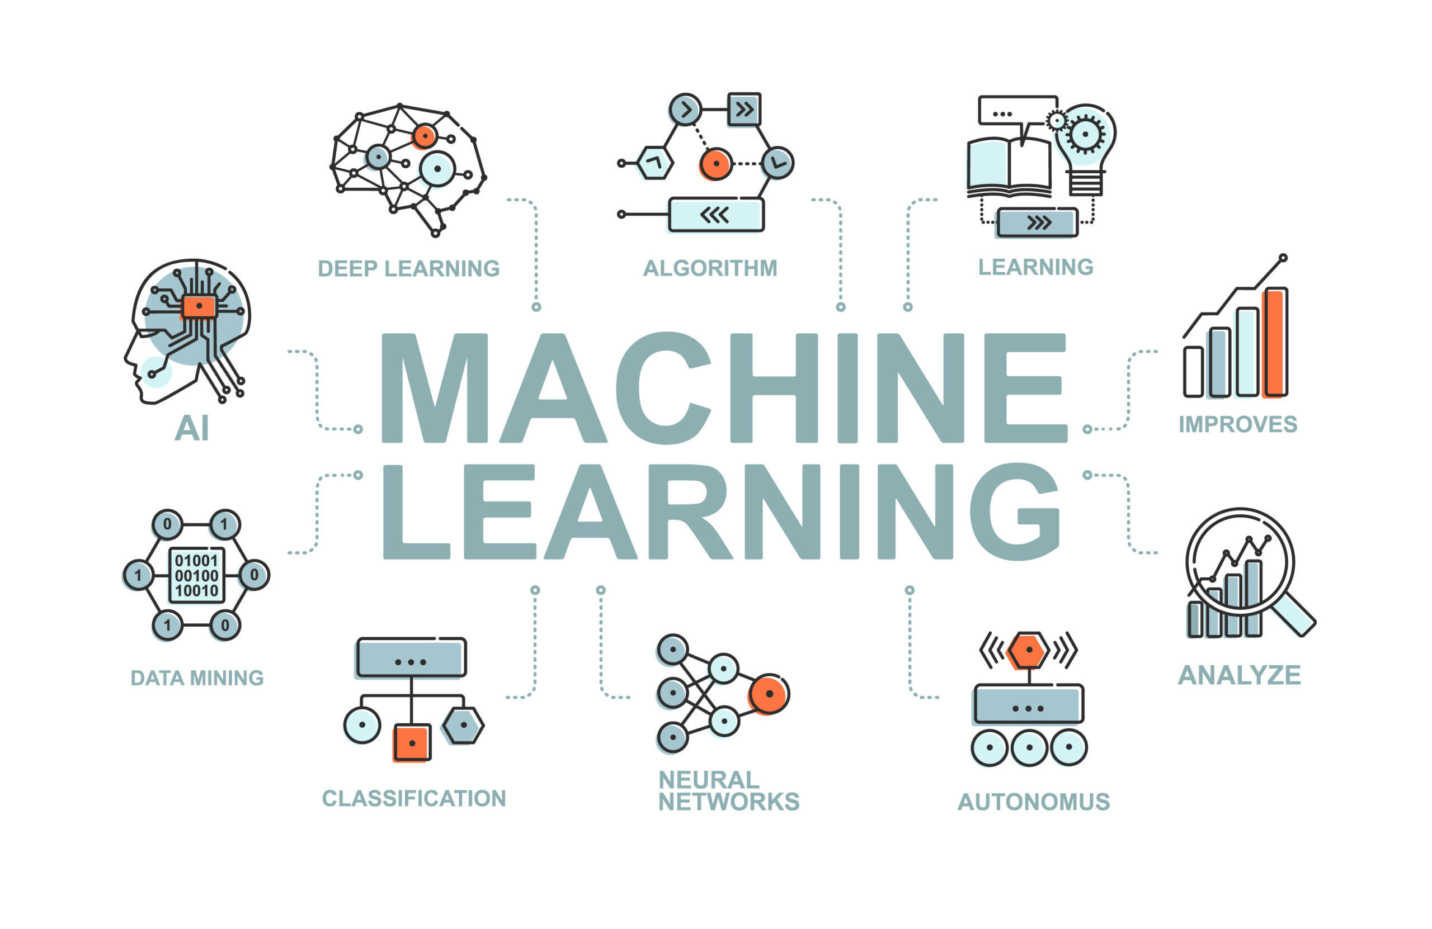

Slide 6
STEPS USED IN MACHINE LEARNING
Collecting data: Be it the raw data from excel, access, text files etc., this step (gathering past data) forms the foundation of the future learning. The better the variety, density and volume of relevant data, better the learning prospects for the machine becomes.
Preparing the data: Any analytical process thrives on the quality of the data used. One needs to spend time determining the quality of data and then taking steps for fixing issues such as missing data and treatment of outliers. Exploratory analysis is perhaps one method to study the nuances of the data in details thereby burgeoning the nutritional content of the data.
Training a model: This step involves choosing the appropriate algorithm and representation of data in the form of the model. The cleaned data is split into two parts – train and test (proportion depending on the prerequisites); the first part (training data) is used for developing the model. The second part (test data), is used as a reference.
Evaluating the model: To test the accuracy, the second part of the data (holdout / test data) is used. This step determines the precision in the choice of the algorithm based on the outcome. A better test to check accuracy of model is to see its performance on data which was not used at all during model build.
Improving the performance: This step might involve choosing a different model altogether or introducing more variables to augment the efficiency. That’s why significant amount of time needs to be spent in data collection and preparation.

Slide 7
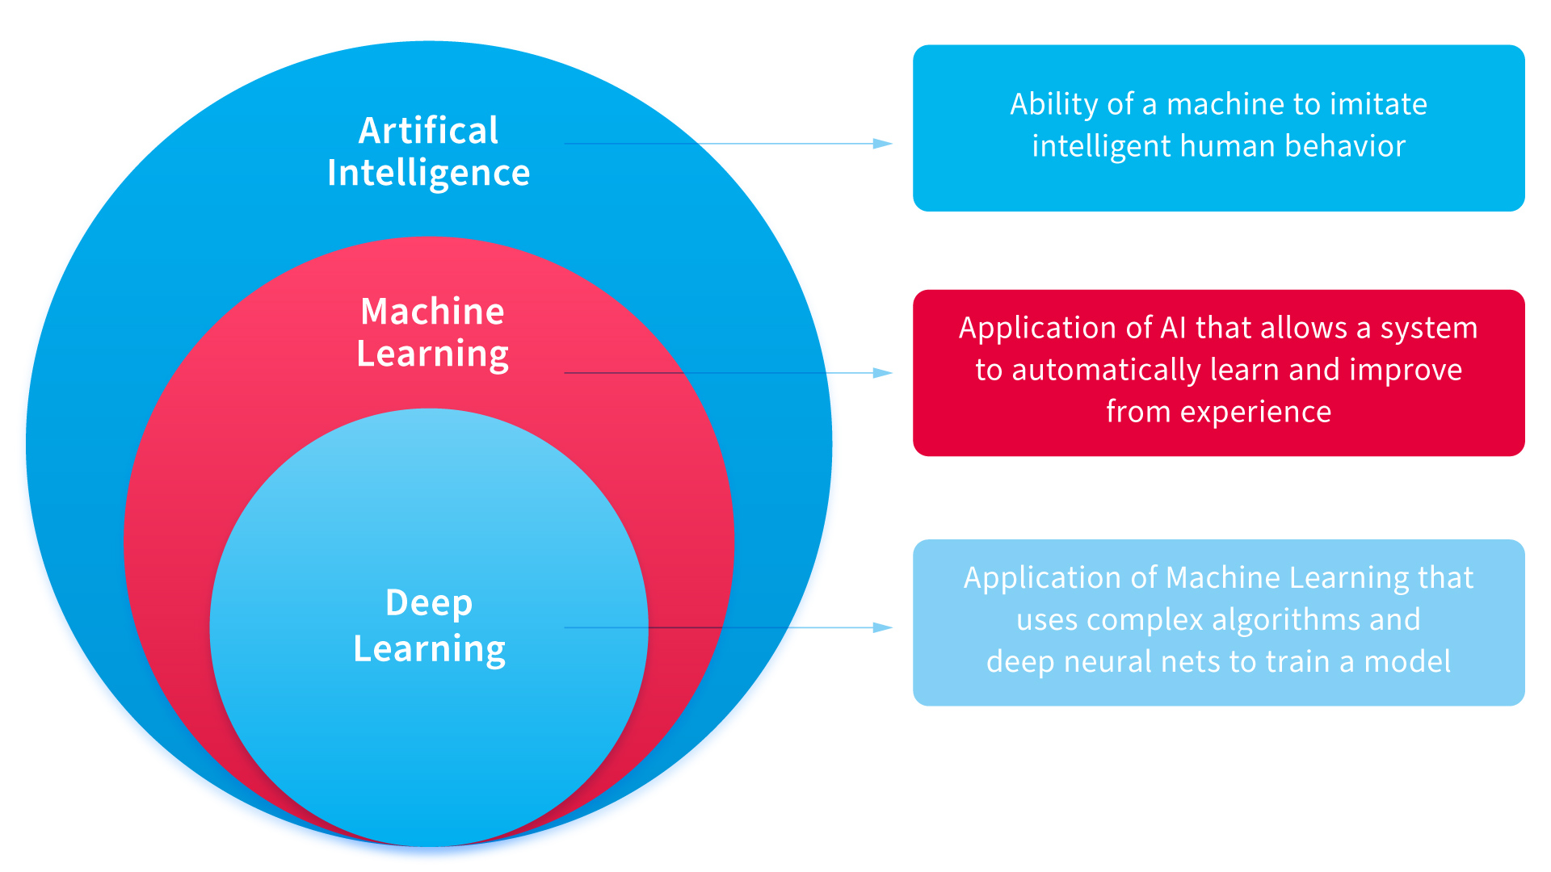
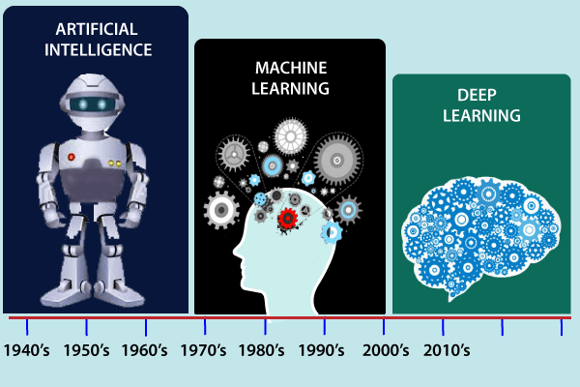
Machine Learning is the field of computer science that uses statistical techniques to give computer systems the ability to learn with Data, without being explicitly programmed.

Slide 8
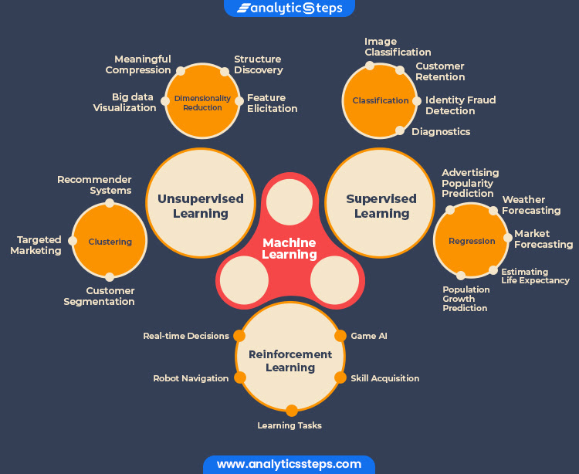

Slide 9
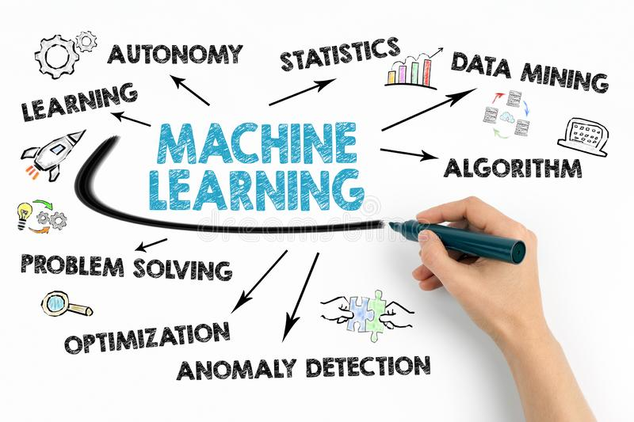
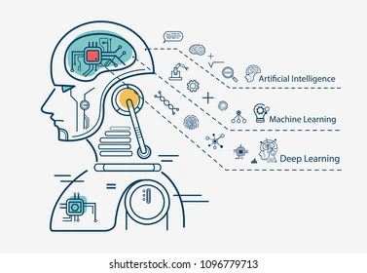

Slide 10
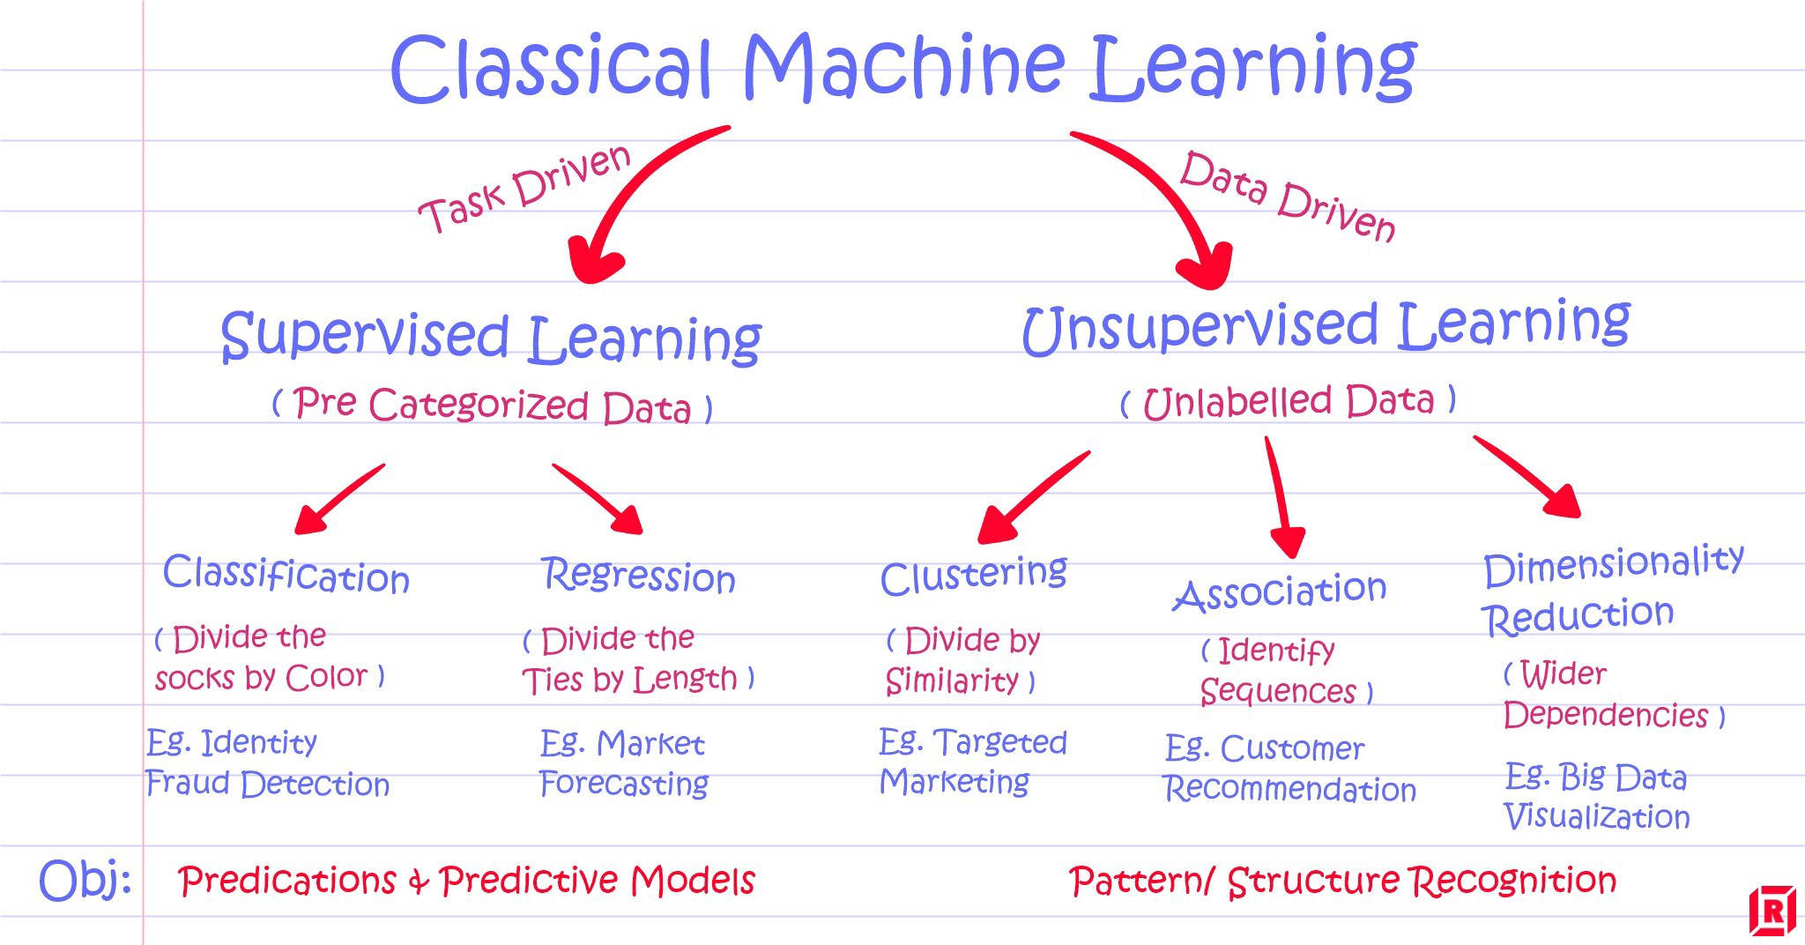

Slide 11
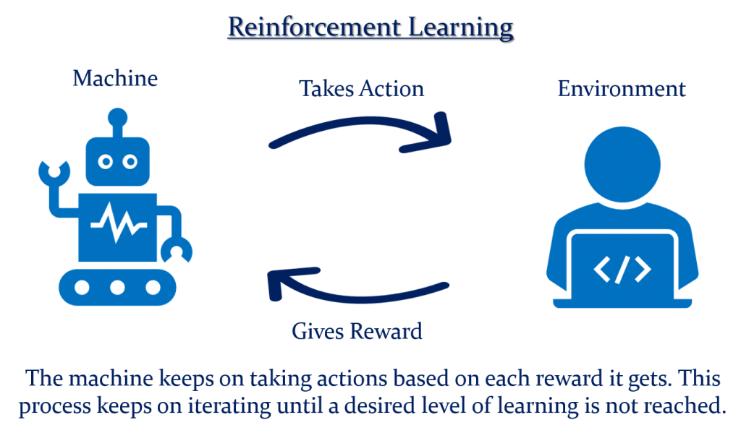

Slide 12
Reinforcement Learning
It is the ability of an agent to interact with the environment and find out what is the best outcome. It follows the concept of hit and trial method.
The agent is rewarded or penalized with a point for a correct or a wrong answer, and on the basis of the positive reward points gained the model trains itself. And again once trained it gets ready to predict the new data presented to it.

Slide 13
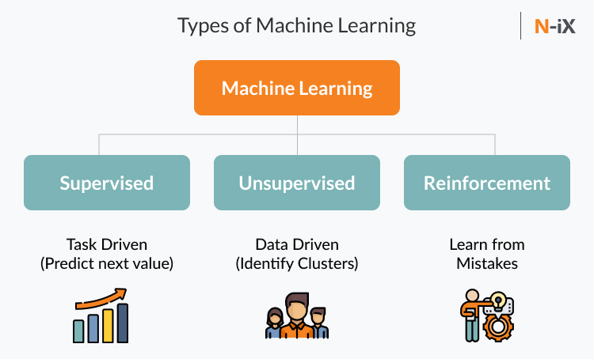
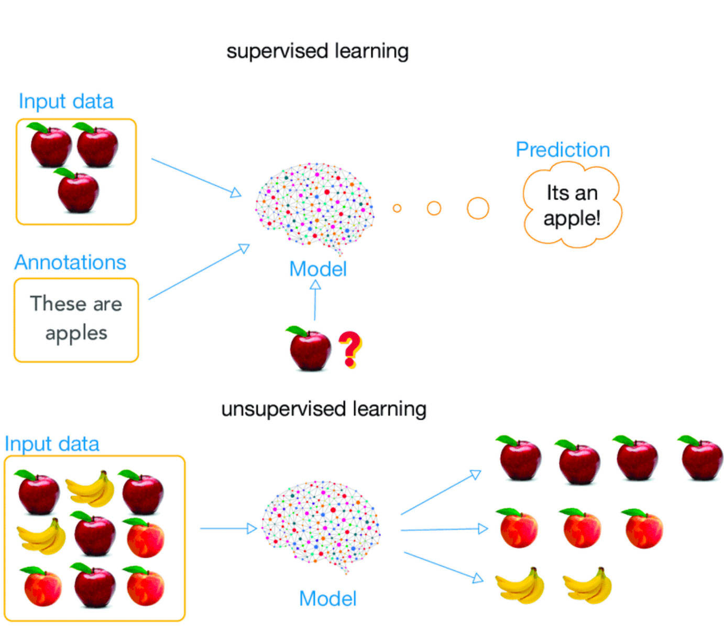
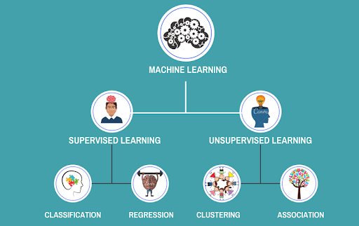

Slide 14
Data Warehousing
Data warehouse refers to the process of compiling and organizing data into one common database.
General stages of the use of a data warehouse:
Offline Operational Database: In this stage, data is copied to a server from an operating system so that loading, processing, and reporting the data does not impact the performance of the operational system.
Offline Data Warehouse: The data stored in the warehouse is regularly updated from the operational database to derive useful business insights.
Real-time Data Warehouse: Whenever a transaction takes place in the operational database, the same is updated in the data warehouse.
Integrated Data Warehouse: Every transaction taking place in the operational database is updated simultaneously in the data warehouse. Then, the warehouse generates transactions that are forwarded to the operational database.

Slide 15
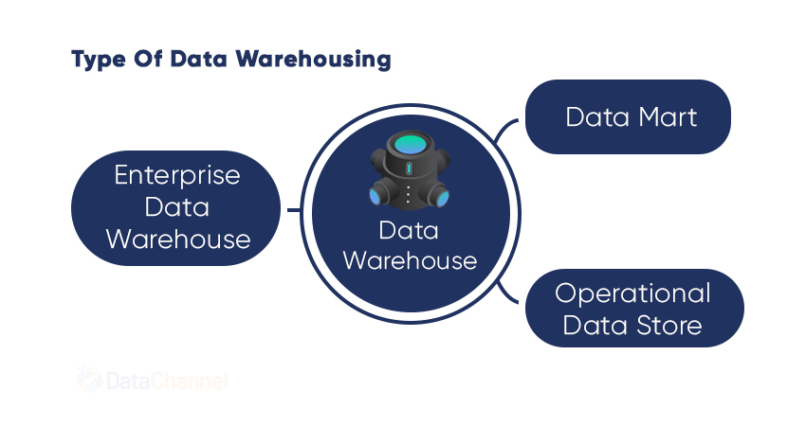
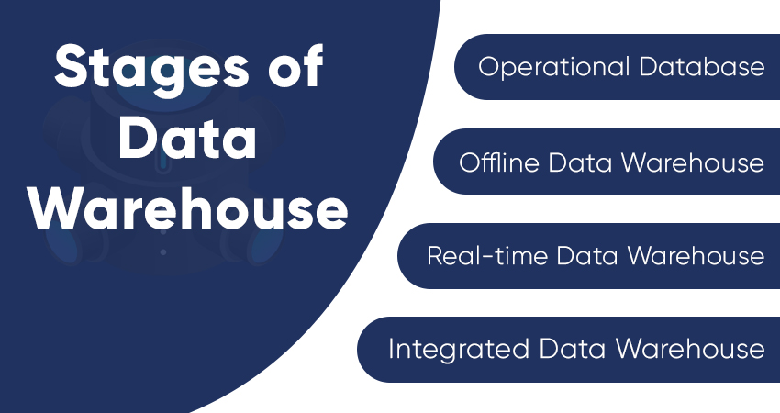

Slide 16
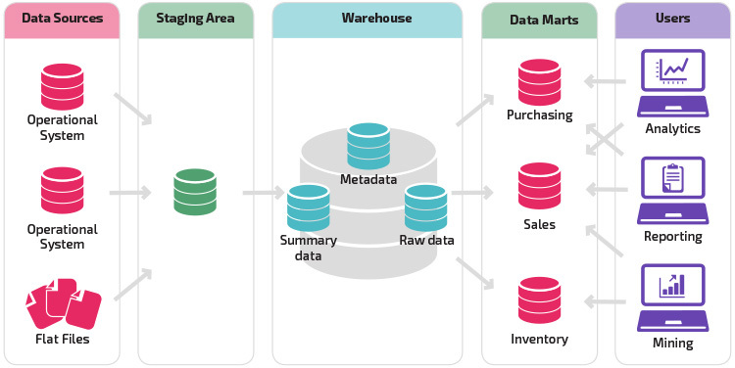


Slide 17
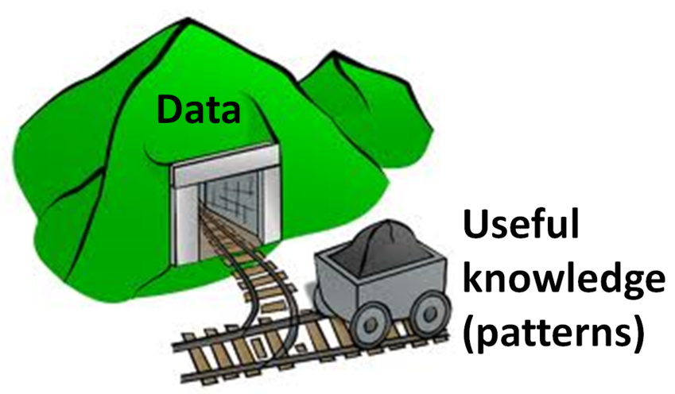
DATA MINING
Data mining is concerned with the analysis and picking out relevant information
Data mining analysts collect as much as raw data as they can to arrive at reliable conclusions and decisions.
As mining operations where large amounts of low grade materials are cleaned and processed in order to find something of value.

Slide 18
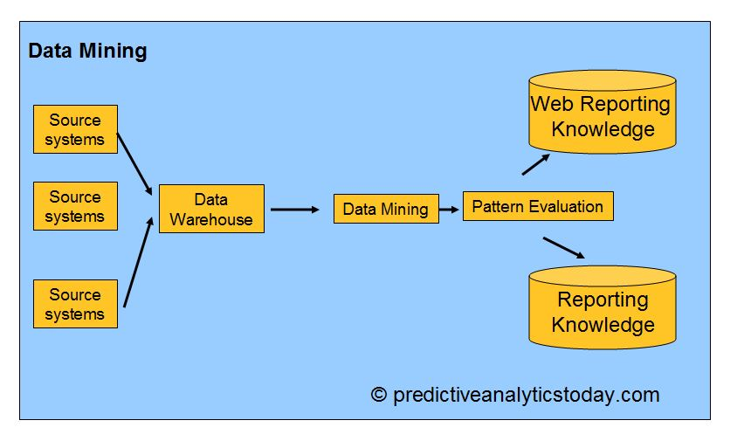

Slide 19
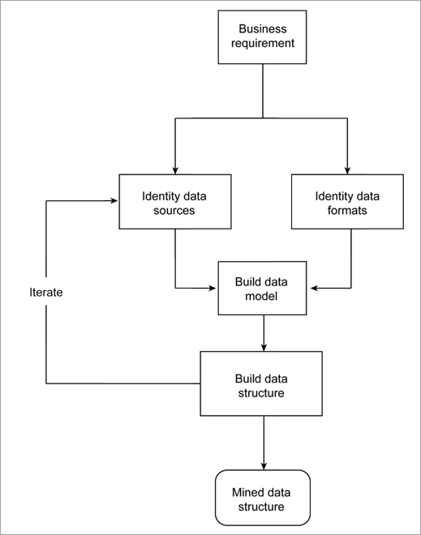
STAGES OF DATA MINING
STAGES OF DATA PREPROCESSING
Data Cleaning
Data Integration
Data Reduction
Data Transformation
Data Mining
Pattern Evaluation
Knowledge Representation

Slide 20
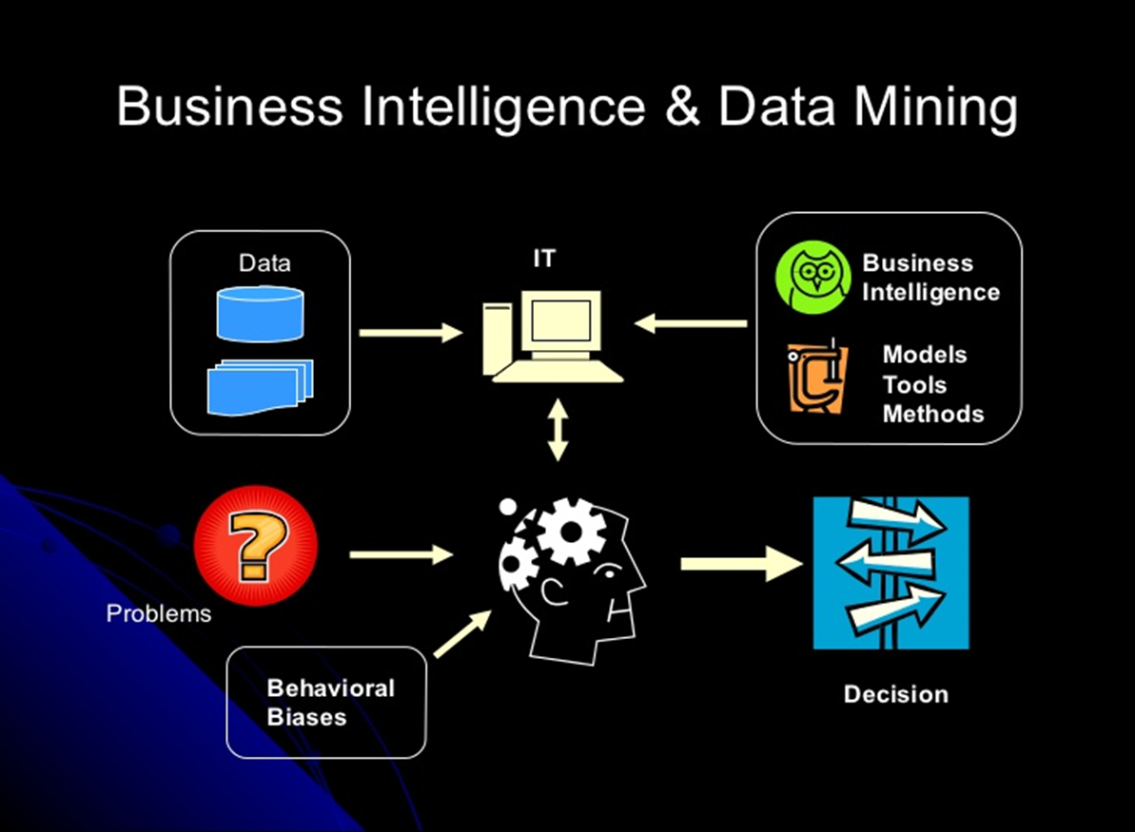
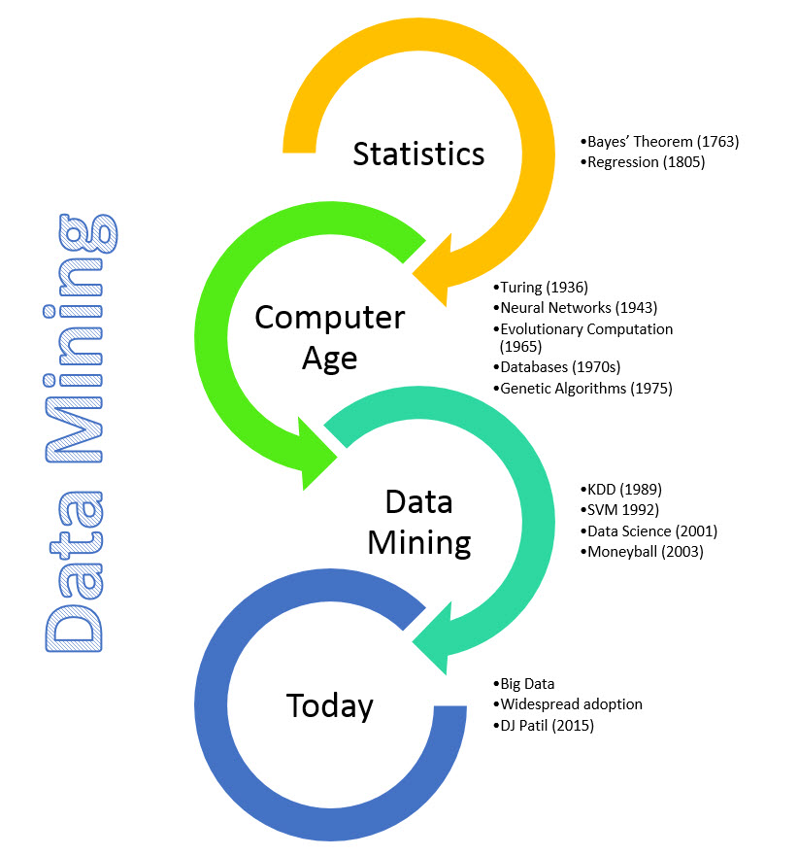

Slide 21
Machine Learning - Algorithms
Linear Regression: Linear regression is used in which value of dependent variable is predicted through independent variables. A relationship is formed by mapping the dependent and independent variable on a line and that line is called regression line which is represented by Y= a*X + b. Logistic Regression: In logistic regression we have lot of data whose classification is done by building an equation. This method is used to find the discrete dependent variable from the set of independent variables. Its goal is to find the best fit set of parameters. In this classifier, each feature is multiplied by a weight and then all are added. Then the result is passed to sigmoid function which produces the binary output.
Decision Tree: It belongs to supervised learning algorithm. Decision tree can be used to classification and regression both having a tree like structure. In a decision tree building algorithm first the best attribute of dataset is placed at the root, then training dataset is split into subsets. Splitting of data depends on the features of datasets. This process is done until the whole data is classified and we find leaf node at each branch. Information gain can be calculated to find which feature is giving us the highest information gain. Decision trees are built for making a training model which can be used to predict class or the value of target variable.
Notes:
Logic regression output is either 0 or 1, T or F, Y or N. Solves classification problems. Uses Sigmoid function or S-curve.
SVM is supervised learning method that looks at data and sorts it in one of the two categories. Height,weight and m or f

Slide 22
Machine Learning - Algorithms
Support vector machine: Support vector machine is a binary classifier. Raw data is drawn on the n- dimensional plane. In this a separating hyperplane is drawn to differentiate the datasets. The line drawn from centre of the line separating the two closest data-points of different categories is taken as an optimal hyperplane. This optimised separating hyperplane maximizes the margin of training data. Through this hyperplane, new data can be categorised
KNN: This method is used for both classification and regression. It is among the simplest method of machine learning algorithms. It stores the cases and for new data it checks the majority of the k neighbours with which it resembles the most. KNN makes predictions using the training dataset directly.
Random Forest: It is a supervised classification algorithm. Multiple number of decision trees taken together forms a random forest algorithm i.e the collection of many classification tree. It can be used for classification as well as regression. Each decision tree includes some rule based system. For the given training dataset with targets and features, the decision tree algorithm will have set of rules. In random forest unlike decision trees there is no need to calculate information gain to find root node. It use the rules of each randomly created decision tree to predict the outcome and stores the predicted outcome. Further it calculates the vote for each predicted target. Thus high voted prediction is considered as the final prediction from the random forest algorithm.
Notes:
K-Means clustering – news, cluster centroid school, monthly salary and saving potential
KNN- Example height,weight,Size(S,M,L)

Slide 23
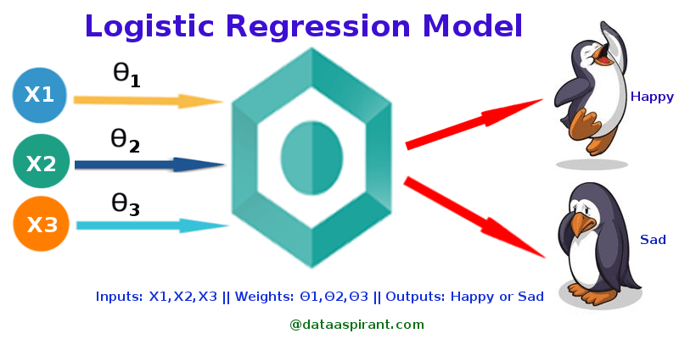
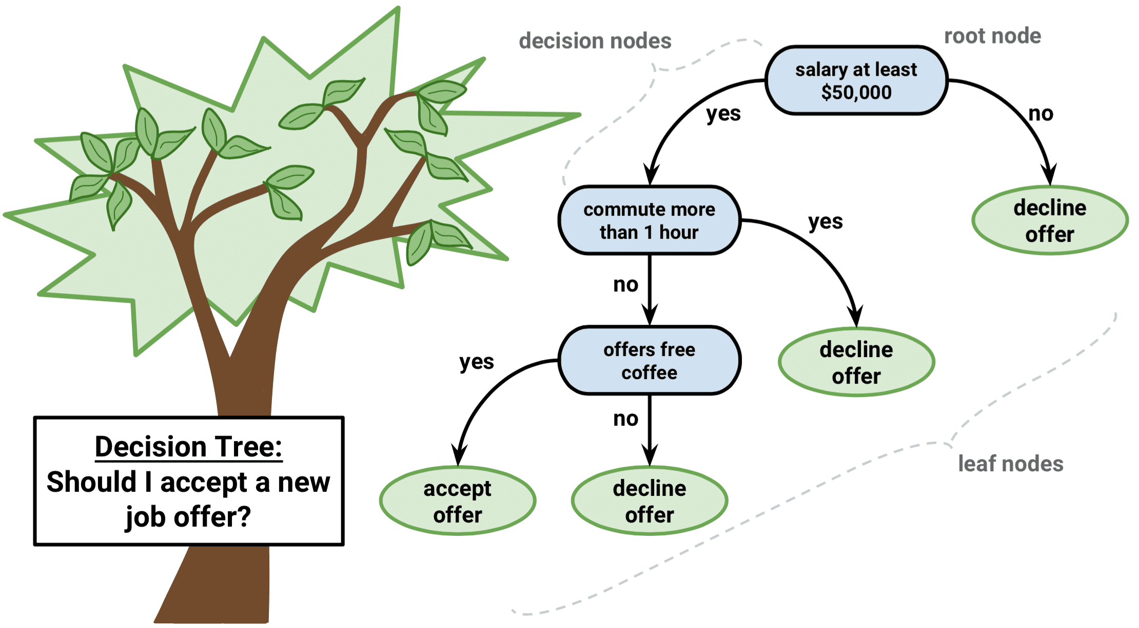

LINEAR REGRESSION

Slide 24
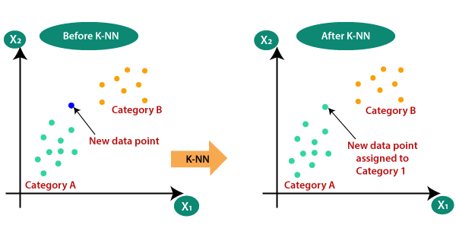
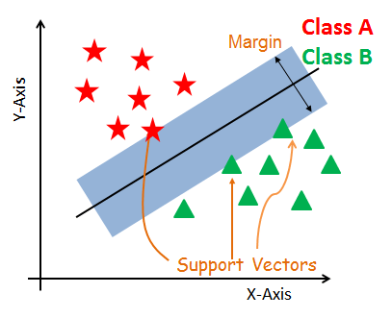
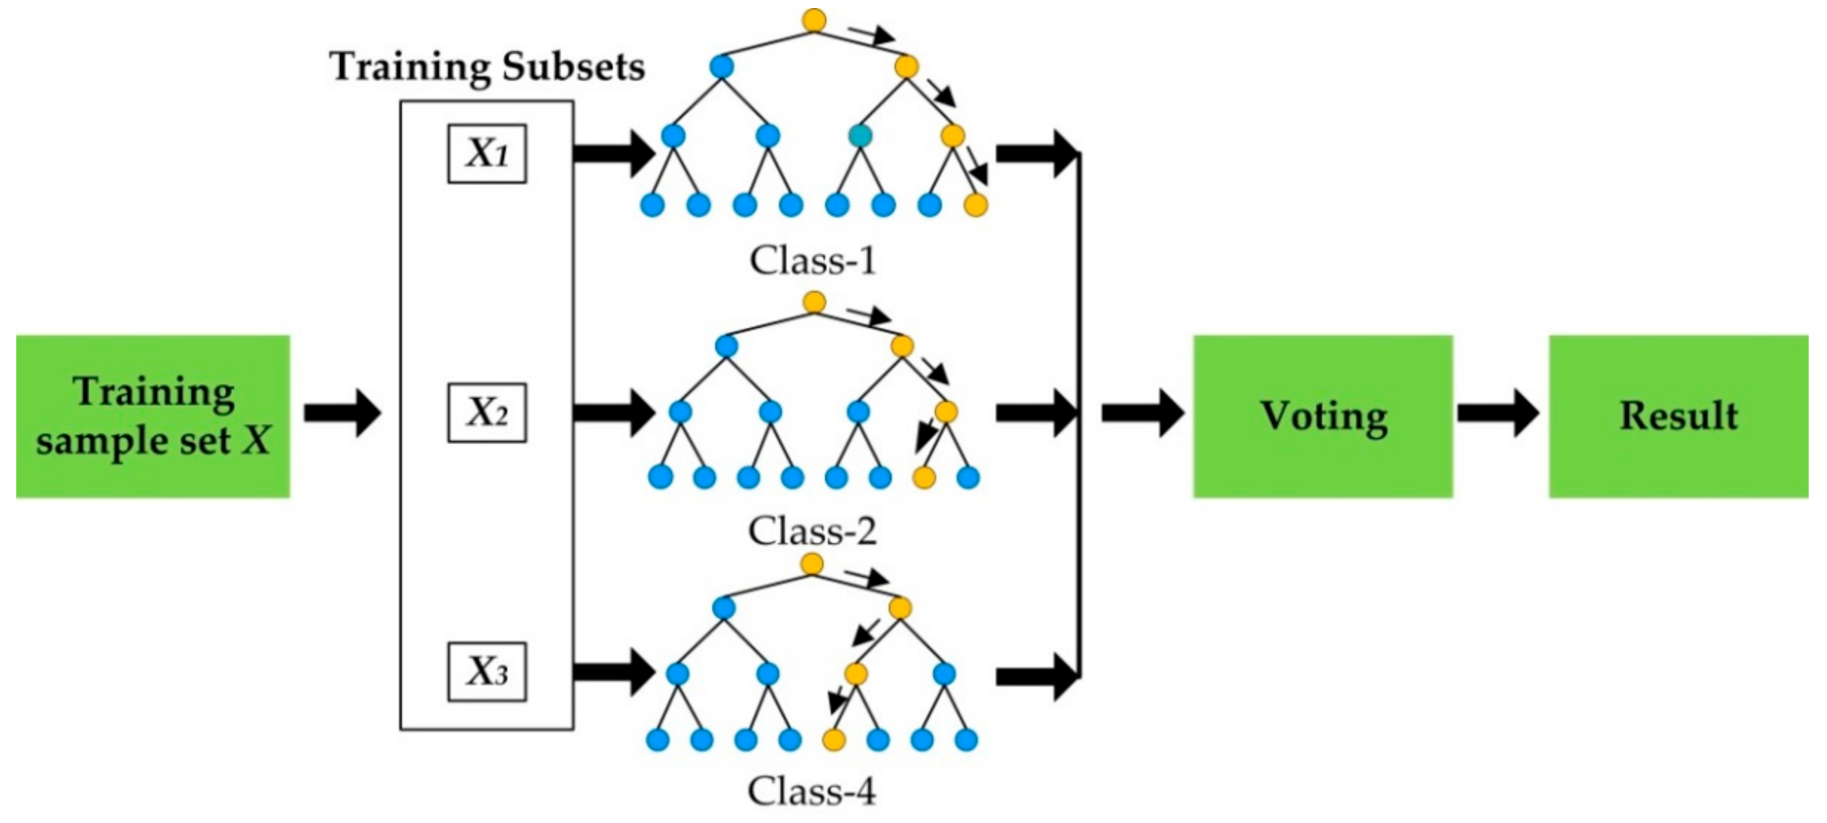
KNN
SVM
RANDOM FOREST

Slide 25
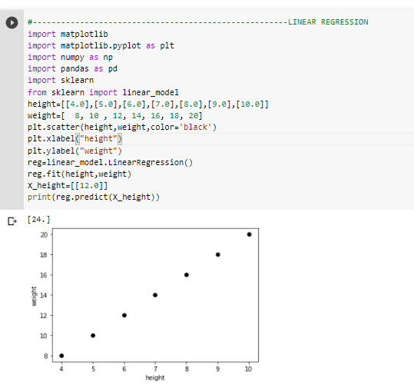
1.LINEAR REGRESSION

Slide 26
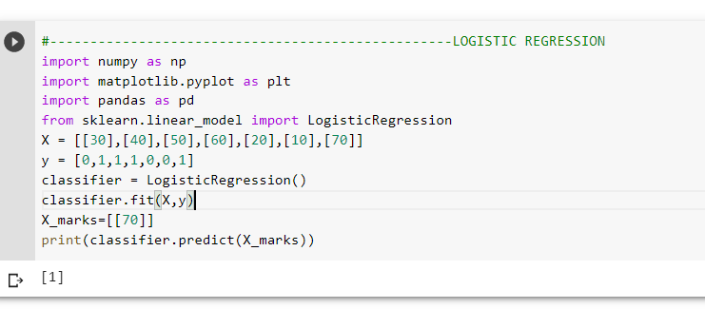
2.LOGISTIC REGRESSION

Slide 27
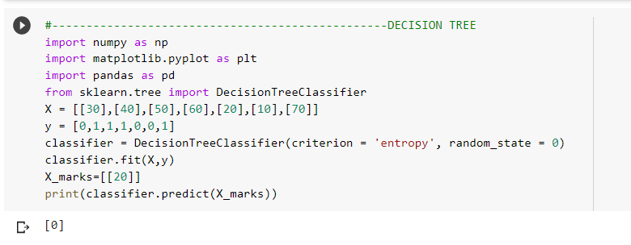
3. DECISSION TREE

Slide 28
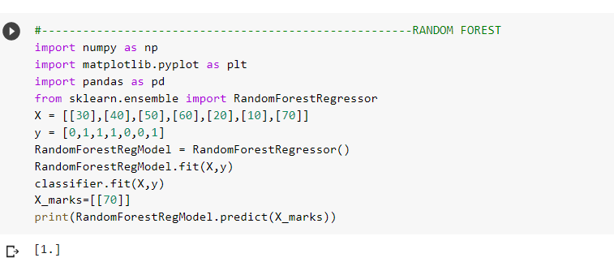
4. RANDOM FOREST

Slide 29
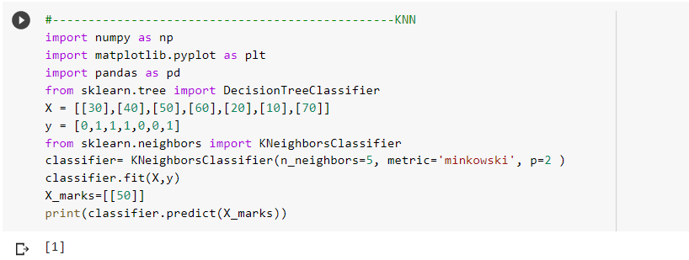
KNN

Slide 30
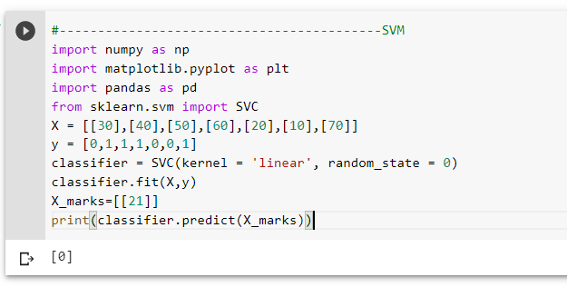
6.SVM
GIT HUB LINK- https://github.com/ENG19CS0334-TEJAAL-M/MACHINE-LEARNING-_ASSIGNMENT-1.git

Slide 31
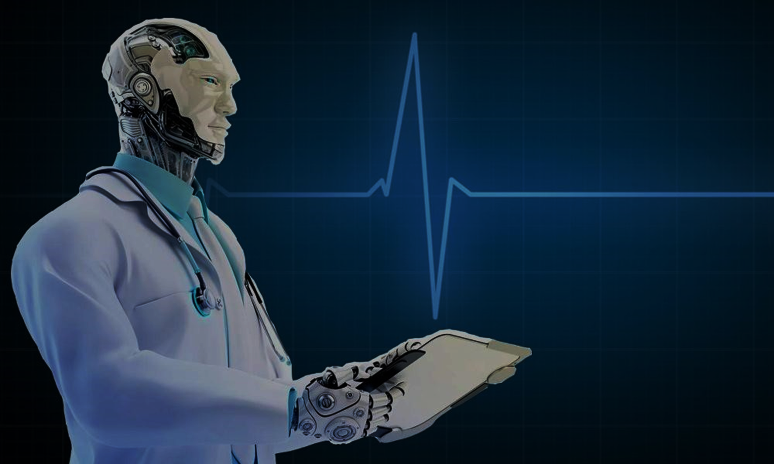
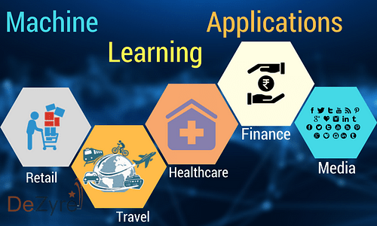
APPLICATIONS OF MACHINE LEARNING

Slide 32
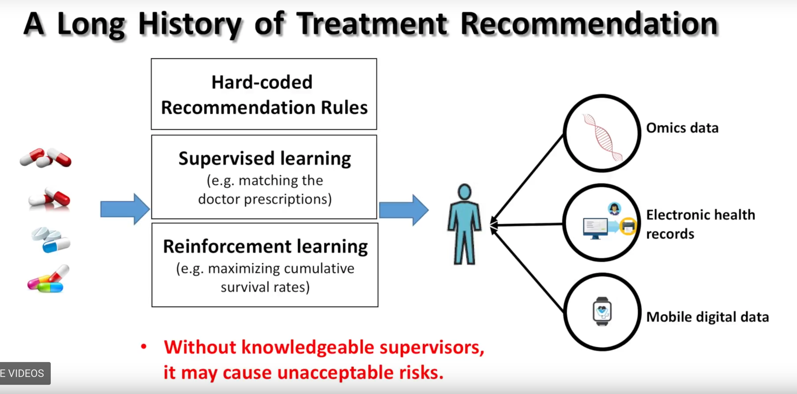
APPLICATION OF ML IN HEALTH CARE

Slide 33
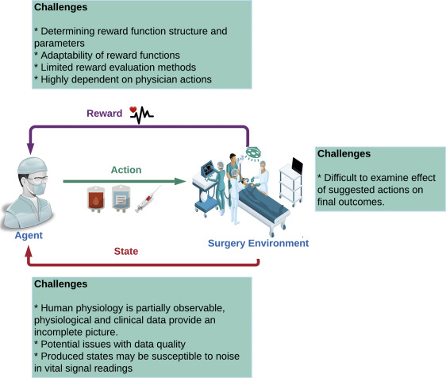
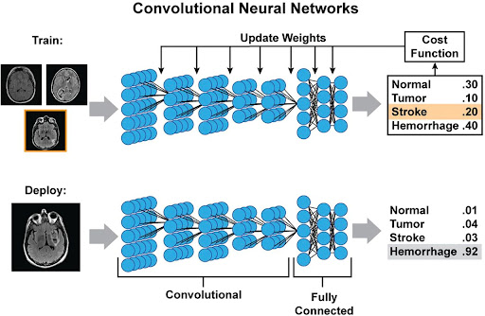

Slide 34
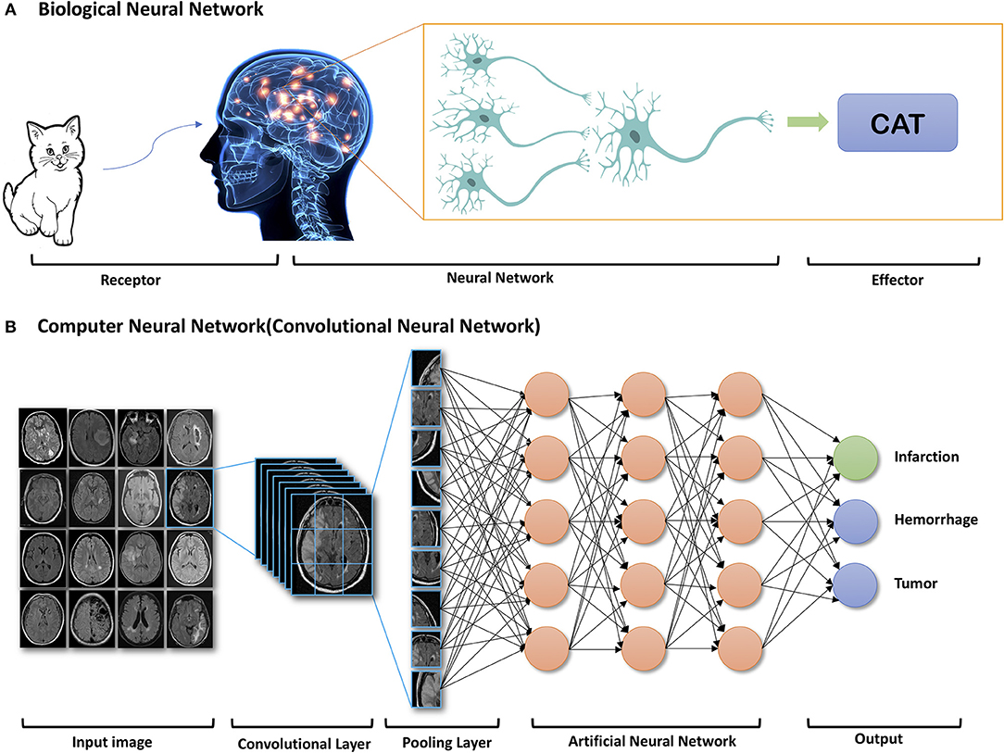

Slide 35
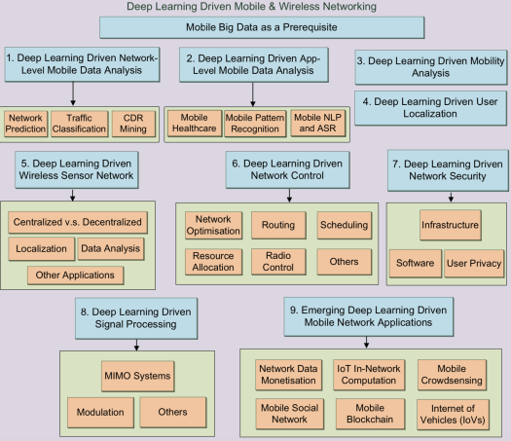
APPLICATION OF ML IN TELECOM

Slide 36
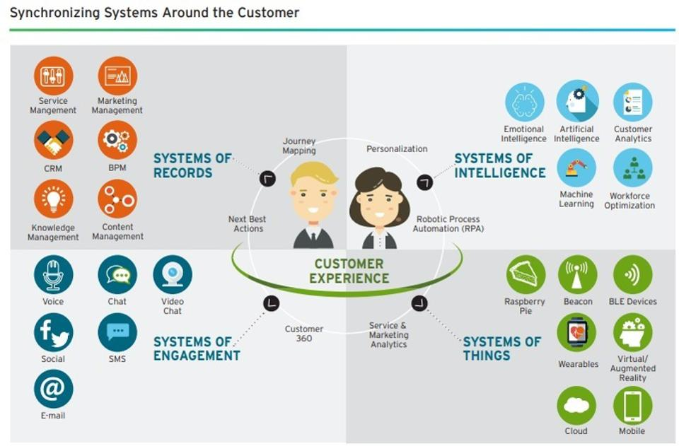

Slide 37
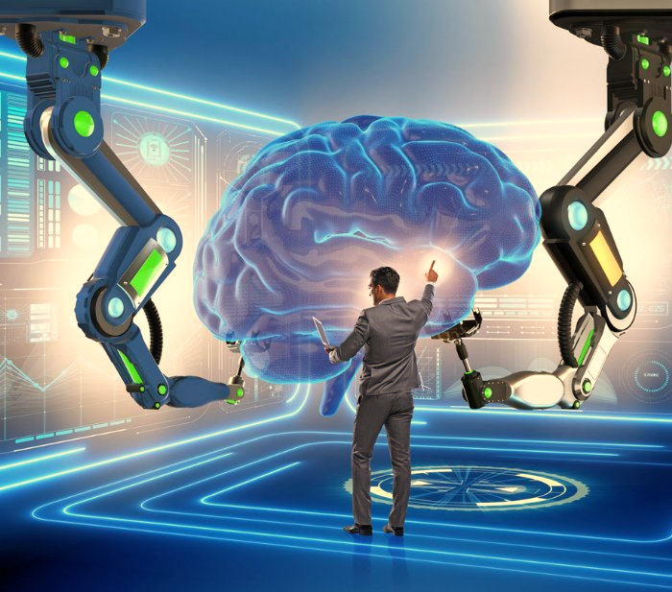
THANK YOU
TEJAAL M
ENG19CS0334
B.Tech CSE
SEM V
F section

